Slide 1
Efficient Searching top-k Semantic Similar Sentence

Slide 2
Outline
Motivation
Application
Challenge
Our Optimized Framework on TKDD’08 paper
TKDD’08 framework
Our framework
Experimental evaluation
Dataset
Experiment results
Conclusion

Slide 3
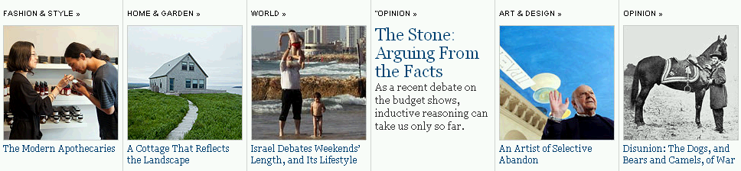

Image retrieval
query
similarity
Image caption text
query
Kherfi et al., CSUR’04, Coelho et al., TKDE’04

Slide 4
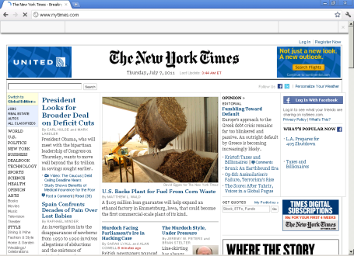
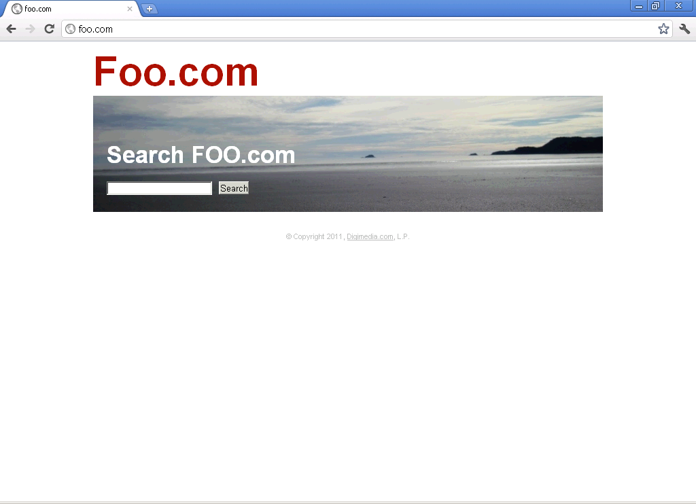


Query-title similarity
query:
Times NewYork
result: ?
Summary of this page
similarity
Title
query
Webpage
Jin SIGIR’02, Cao SIGIR’05, Xue SIGIR’08
Notes:
具体的应用要说出来.

Slide 5

Query-anchor text similarity
query
Summary of related page
Anchor text
similarity
Anchor text
query
Webpage
Eiron SIGIR’03, Craswell SIGIR’01, Kraft WWW’04, Dang WSDM’10
Notes:
换一个比较明显的link，中间的只要对应上面的html的source。四个图叠加，每个都引出一个anchor text，对应的是同一个webpage，用一个query，实际上是跟多个anchor text做对比，可以综合考虑。

Slide 6
Outline
Motivation
Application
Challenge
Our Optimized Framework on TKDD’08 paper
TKDD’08 framework
Our framework
Experimental evaluation
Dataset
Experiment results
Conclusion

Slide 7
Problem definition
Data Collection:
Query:
Mother is a teacher.
Father is a worker.
It is sunny today.
top-2 similar sentences:
My sister is working at Toyota.
My sister is working at Toyota.
Mother is a teacher.
Noon is 12 o’clock.
Problem definition
Cord is Strong, thick string.
I like eating cake.
Given a query sentence q and a data collection C, find top-k most similar sentences from C with regard to q.
Today is Friday.
A voyage is a long journey on a ship or in a spacecraft.
Notes:
用户要找出与query最相近的sentence，并不一定需要知道每一队Similarity的值。

Slide 8
Challenge
Data collection
Query sentence
sentence
sentence
Efficient
sentence
sentence
sentence
Indexing based on some order
sentence
Time consuming
sentence
sentence
sentence
sentence
…
Compute all sentences in the collection
[TKDE’06, AAAI ’06, TKDD’08]
Notes:
Traditional work.
Key iead: 不需要计算所有的sentence，我们只要计算很少的sentence。
怎么来实现： 我们在预处理的时候要对list进行预先的排序，具体是与Similarity相关的，具体的手法我们在后面的slides要进行介绍的。
在query的时候我们只要比较前面的一部分就可以了， 它们是有一定的优先顺序的。
在query的时候，不需要比较所有的Similarity了。
Keyiead: 怎么找到这个顺序，怎么找到对应的order？
~~~

Slide 9
Related work
Methodology
String Similarity based (TKDE’06, TKDD’08)
Corpus Similarity based (TKDD’ 08, JAF’10, SIGIR’09)
WordNet Similarity based (TKDE’06, SIGIR’07)
Common Order Similarity based (TKDE’06, TKDD’08)
Notes:
刚才是challenge。
我们现在想做的是提高速度，只是比较一部分。我们的idea是进行排序。
我们如何找order。
下面我来介绍相关work
基于sentence的研究是： xxx，xx，xxx。
Application是重复的。

Slide 10
A General Framework
TKDD’08 paper by Islam et al.
String similarity based
Corpus similarity based
Common word order similarity based
Pros and Cons
Effectiveness aware, i.e., most effective
Efficiency unaware
 | Effectiveness | Efficiency
TKDD’08
Our proposal
O
X
O
O
Islam et al., “Semantic Text Similarity Using Corpus-Based Word Similarity and String Similarity”, ACM Transaction on Data Mining and Knowledge Discovery (TKDD’08)
Notes:
我们要基于一个general Framework，TKDD’08里面描述的，最新的，考虑比较全面的一个Framework，我们的proposal也是基于它的一个Framework。

Slide 11
Outline
Motivation
Application
Challenge
Our Optimized Framework on TKDD’08 paper
TKDD’08 framework
Our framework
Experimental evaluation
Dataset
Experiment results
Conclusion

Slide 12
TKDD’08 Framework
Sentence Similarity
Word String Similarity
Word Semantic Similarity
Common word Order Similarity
Combinational Similarity
NLCS
NMCLCS1
NMCLCSn
SOC-PMI
String Similarity
Notes:
Keep the Similarity measure the same as TKDD’08 paper.
Improve the efficiency of computation.
前后的Framework的表示要一样。
把order用虚线来表示。
前后要统一。
用不同的图形来区分开来。

Slide 13

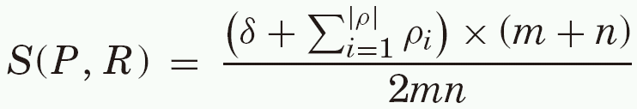
TKDD’08 Similarity Methodology
Sentence P
wordP1, wordP2, wordP3, wordP4, wordP5, wordP6
Sentence R
wordR1, wordR2, wordR3, wordR4
For each sentence pair similarity
String Similarity = 0.33*NLCS+0.33*NMCLCS1 + 0.33*NMCLCSn
Combinational Similarity = 0.5*String Similarity + 0.5*Semantic Similarity
Common Word Order Similarity
#words of Sentence P
Number of Common Words
Order Similarity Weight
#words of Sentence Q
String and Semantic Similarity
Notes:
P 中的word1和q中的word1要用下标来表示

Slide 14
String Similarity- NLCS
Sentence Similarity
Word String Similarity
Word Semantic Similarity
Common word Order Similarity
Combinational Similarity
NLCS
NMCLCS1
NMCLCSn
SOC-PMI
String Similarity
Notes:
Keep the Similarity measure the same as TKDD’08 paper.
Improve the efficiency of computation.
前后的Framework的表示要一样。
把order用虚线来表示。
前后要统一。
用不同的图形来区分开来。

Slide 15


String Similarity (NCLS)
NLCS (Normalized Longest Common Substring)
String P
a | b | a | c | d
String R
a | c | a | d | b

Slide 16
String Similarity (NMCLCS1)
Sentence Similarity
Word String Similarity
Word Semantic Similarity
Common word Order Similarity
Combinational Similarity
NLCS
NMCLCS1
NMCLCSn
SOC-PMI
String Similarity
Notes:
Keep the Similarity measure the same as TKDD’08 paper.
Improve the efficiency of computation.
前后的Framework的表示要一样。
把order用虚线来表示。
前后要统一。
用不同的图形来区分开来。

Slide 17



String Similarity(NMCLCS1)
NMCLCS1 (Normalized Maximal Consecutive LCS starting at character 1)
String P
a | b | d | e
a | b | a
String R
a | c | d | e
b | b | a
Not Consecutive
Not the Same First
Character
MCLCS1 = 1
MCLCS1 = 0

Slide 18
String Similarity (NMCLCSn)
Sentence Similarity
Word String Similarity
Word Semantic Similarity
Common word Order Similarity
Combinational Similarity
NLCS
NMCLCS1
NMCLCSn
SOC-PMI
String Similarity
Notes:
Keep the Similarity measure the same as TKDD’08 paper.
Improve the efficiency of computation.
前后的Framework的表示要一样。
把order用虚线来表示。
前后要统一。
用不同的图形来区分开来。

Slide 19


String Similarity(NMCLCSn)
NMCLCSn (Normalized Maximal Consecutive LCS starting at any character n)
String P
a | b | d | e
a | b | a
String R
a | c | d | e
b | b | a
Maximal Consecutive
MCLCSn=2
MCLCSn = 2
String Similarity = 0.33*NLCS+0.33*NMCLCS1 + 0.33*NMCLCSn
Notes:
第三个不要
abd要加 一个e

Slide 20
Semantic Similarity (SOC-PMI)
Sentence Similarity
Word String Similarity
Word Semantic Similarity
Common word Order Similarity
Combinational Similarity
NLCS
NMCLCS1
NMCLCSn
SOC-PMI
String Similarity
Notes:
Keep the Similarity measure the same as TKDD’08 paper.
Improve the efficiency of computation.
前后的Framework的表示要一样。
把order用虚线来表示。
前后要统一。
用不同的图形来区分开来。

Slide 21
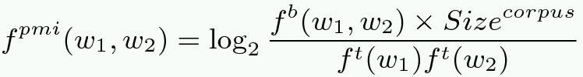
Semantic Similarity
PMI
f(w1, w2)
Problem: frequency is very low because prob. of two words in a sentence is small
Solution: SOC-PMI (Second Order PMI)
window
window
(Corpus)
“……………………………w1a,w1y,w1,w1c,w1h,………w1t,w1f,w1,w1g,w1n,……………………”
pmi
pmi
pmi
pmi
pmi
pmi
pmi
pmi
pmi
pmi
w2
w2
Sorting PMI value
Remove the noisy value
Linear aggregation
Notes:
用竖的list；
Appendix；
如何把所有的pmi合并；
说出key idea；
不需要解释具体的公式的意义；
综合考虑这三个，最后算出来总的结果。
取前面的n个值，不然就是你noisey，reasonable solution是把这些所有的值做一个平均。
取一个综合的线性的叠加。

Slide 22
Combinational Similarity
Sentence Similarity
Word String Similarity
Word Semantic Similarity
Common word Order Similarity
Combinational Similarity
NLCS
NMCLCS1
NMCLCSn
SOC-PMI
String Similarity
Notes:
Keep the Similarity measure the same as TKDD’08 paper.
Improve the efficiency of computation.
前后的Framework的表示要一样。
把order用虚线来表示。
前后要统一。
用不同的图形来区分开来。

Slide 23
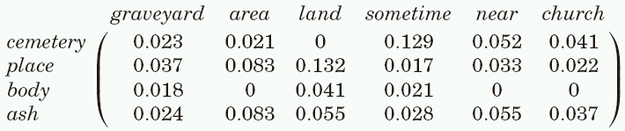
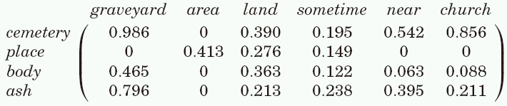
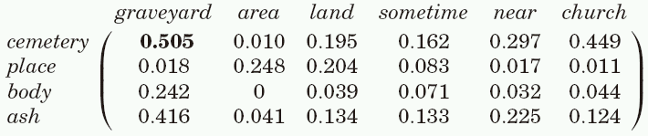
String and Semantic Combination
Sentence P: graveyard area land sometime near church
Sentence R: cemetery place body ash
String Similarity
0.5*String Similarity+0.5*Semantic Similarity
Semantic Similarity
Combinational Similarity

Slide 24
Overall Similarity
Sentence Similarity
Word String Similarity
Word Semantic Similarity
Common word Order Similarity
Combinational Similarity
NLCS
NMCLCS1
NMCLCSn
SOC-PMI
String Similarity
Notes:
Keep the Similarity measure the same as TKDD’08 paper.
Improve the efficiency of computation.
前后的Framework的表示要一样。
把order用虚线来表示。
前后要统一。
用不同的图形来区分开来。

Slide 25

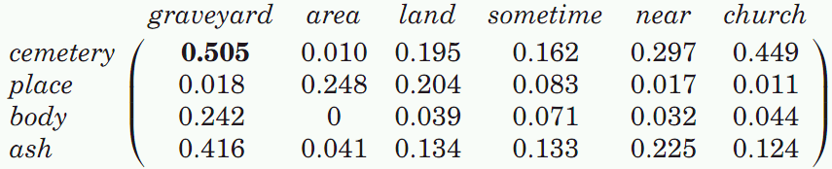

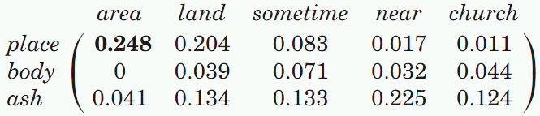


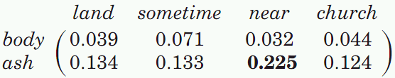


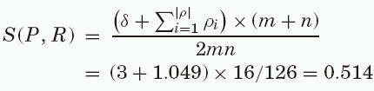
Overall Sentence Similarity
(1)
(2)
(3)
(4)
0.505 + 0.248 + 0.225 + 0.071 = 1.049
Notes:
说明的时候强调String与semantic，不用order
Heuristic approach

Slide 26
Outline
Motivation
Application
Challenge
Our Optimized Framework on TKDD’08 paper
TKDD’08 framework
Our framework
Experimental evaluation
Dataset
Experiment results
Conclusion

Slide 27
Problem of TKDD’08 paper
Sentence Data Collection
Word String Similarity
Word Semantic Similarity
Top-k
S1
S1
?
S2
S2
?
S3
S3
?
S4
S4
?
S5
S5
?
S6
S6
?
S7
S7
?
Sorting to find top-k
Computing all similarity pair

Slide 28
Our Proposal(1/2)
Effectiveness: same word pair similarity as TKDD’08
Efficiency: optimization on order of computing similarity
Sentence Data Collection
String Similarity
Semantic Similarity
Top-k
S3
S4
?
S2
S7
?
S5
S5
?
Sorting based on some order
S6
S3
?
S4
S1
?
S7
S6
?
S1
S2
?
Rank list
Rank list
Key idea: Rank aggregation
Notes:
我们改变的是workflow，我们现在不改变word pair级别的Similarity，改变的计算顺序；

Slide 29
Our Proposal(2/2)
Sentence Data Collection
String Similarity
Semantic Similarity
Top-k
S3
S4
?
Ordered
S2
S7
?
S5
S5
?
S6
S2
?
S4
S1
?
S7
S6
?
S1
S2
NLCS
NMCLCS1
NMCLCSn
word1
word2
word3
S3
S1
S1
…
…
…
Ordered
S2
S3
S2
…
…
…
top-k
top-k
S1
S2
S3
…
…
…
word1
word2
word3
word1
word2
word3
word1
word2
word3
…
…
…
…
…
…
…
…
…
top-k
…
…
…
top-k
…
…
…
top-k
…
…
…
…
…
…
…
…
…
…
…
…
Key idea: Threshold Algorithm(PODS’01)
Notes:
强调： 看起来比较complex，实际上就是： 给定两个list，计算总的list的top-k，而rank aggregation的一个比较classic的一个Research。

Slide 30





Index for NLCS
q: query string
R: string in Data Collection
Example:
abcd
abcd
abc,abd,acd,bcd
ab,ac,ad,bc,bd,cd
a,b,c,d
Feature
Length(q) | const
LCS(q,R) | variable
Length(R) | variable
Index grams
filtering
Ascending Ordered
of word length
gram
NLCS(q,R) | LCS(q,R) | Length(R)
abcd
abd
acd
bcd
ab
ac
…
 | abecdf, abcdfgh
 | abd, abdef, abfedg
 | abcfe,abfceg
 | bcefsd,bfcdfgh
 | ...
 | …
 | …
q: query word; S: NLCS of two strings
G: length of gram1; g: length of gram2;
Descending Ordered of gram
gram
threshold =
top-1: abd

Slide 31


Old---Index for NLCS
q: query string
R: string in Data Collection
Example:
abcd
abcd
abc,abd,acd,bcd
ab,ac,ad,bc,bd,cd
a,b,c,d
Feature
Index grams
LCS(q,R) | variable
Length(q) | const
Length(R) | variable
filtering
Ascending Ordered
of word length
gram
abd
abcd
acd
bcd
ab
ac
…
9/3 | abd, abdef, abfedg
16/6 | abecdf, abcdfgh
9/5 | abcfe,abfceg
9/6 | bcefsd,bfcdfgh
 | ...
 | …
 | …
variable
Descending Ordered of threshold
threshold=
threshold order
word length order
top-1: abd

Slide 32



NMCLCS1 Ranking
q: query string
R: string in Data Collection
Example:
abcd
abcd
abc
ab
a
Feature
NMCLCS1(q,R) | variable
Length(q) | const
Length(R) | variable
Index grams
filtering
Ascending Ordered
of word length
gram
abc
abcd
ab
a
9/3 | abc, abcdf, abcedg
16/6 | abcdef, abcdfgh
4/5 | abfed,abfceg
1/6 | acefsd,bfcdfgh
variable
Descending Ordered of threshold
threshold=
threshold order
top-1: abc
word length order

Slide 33



NMCLCSn Ranking
q: query string
R: string in Data Collection
Example:
abcd
abcd
abc, bcd,
ab,bc,cd
a,b,c,d
Feature
Index grams
NMCLCSn(q,R) | variable
Length(q) | const
Length(R) | variable
filtering
Ascending Ordered
of word length
gram
abc
abcd
bcd
abc
ab
bc
…
9/3 | abc, abdef, abfedg
16/6 | abecdf, abcdfgh
9/5 | abcde,abfceg
9/6 | abcfsd,bfcdfgh
 | ...
 | …
 | …
variable
Descending Ordered of threshold
threshold=
threshold order
word length order
top-1: abc

Slide 34



Corpus Ranking
q: query string
R: string in Data Collection
m: corpus size
Example:
abcd
set: m= 100000, f(abcd) = 500, f(abcd,fan)=40
f(abcd,intel)=80
frequency
top-k
7.32
Feature
50
100
320
420
490
630
680
690
720
…
fan
intel
face
tag, gun
bag
…
…
…
…
…
8.32
f(q,R) | variable
f(q) | const
f(R) | variable
Descending Ordered of frequency
for a query q
set
count1
count2
count3
count4
count5
count6
…
find bound
Iteration 1:
threshold = 7.32, bound = 625
Iteration 2:
threshold = 8.32, bound = 312
top-1: intel

Slide 35
Outline
Motivation
Application
Challenge
Our Optimized Framework on TKDD’08 paper
TKDD’08 framework
Our framework
Experimental evaluation
Dataset
Experiment results
Conclusion

Slide 36

Dataset and statistics
(1) [65 pairs] benchmark dataset (TKDE’06, LNAI’08)
65 sentence pair, 32 volunteers, native speakers of English
(2) [BNC]
http://www.natcorp.ox.ac.uk/
(British National Corpus) 100 million words
Dataset Statistics
(1) Original; (2) After Preprocessing
 | 65 pairs |  | BNC
 | (1) | (2) | (1) | (2)
Avg. sentence length | 6.12 | 6.12 | 7.19 | 11.72
Min sentence length | 3 | 3 | 1 | 1
Max sentence length | 12 | 20 | 107 | 38
Max word length | 21 | 21 | 133 | 133
Notes:
有一些 ******************, ------------------
需要把最大的或者最小的word是什么挑出来吗------
……&&（&（*&（*&（*&
最长的word是什么，列举出来。Appendix或者随时准备好给他们看。

Slide 37
Implementation
Baseline: Our implementation of TKDD’08 paper
Effectiveness
Similarity score comparison of TKDD’08, Baseline and our proposal
Efficiency
Query time (seconds)
Notes:
Validation 的用法？？？
Precision？Effecitveness?

Slide 38
Outline
Motivation
Application
Challenge
Our Optimized Framework on TKDD’08 paper
TKDD’08 framework
Our framework
Experimental evaluation
Dataset
Experiment results
Conclusion

Slide 39
Accuracy
Similarity
Sentence ID (by: TKDD’08)
Analysis:
Most of the results is similar with TKDD’08 paper.
Reasons for difference:
BNC version number;
Selection of stopword.
Notes:
TKDE’06 的结果去掉。。。
Human去掉
加上baseline。
就加上3根线

Slide 40
Stopword Selection
Similarity
Sentence ID (by: TKDD’08)
 | StopWord1 | StopWord2 | StopWord3 | StopWord4
variance | 0.082404 | 0.088392 | 0.061628 | 0.076591
Notes:
方差。
第三个是导致Similarity最相似的
最similar with TKDD’08 paper

Slide 41
Efficiency Evaluation
Data collection
Randomly extracted from BNC as our data collection
1k, 5k, 10k, 50k sentences
Different Data Collection
Query time(sec)
Data Collection Name
> Average query time by 10 random queries
> Top 5 results
> Average query size: 4
Notes:
65的不要

Slide 42
Effect on Query size
Query time
Query size
> Average query time by 10 queries
> Dataset size = 5k
> top-5 results
Query time is sensitive with query size
Notes:
直接用2，4 ，6， 8，10。

Slide 43
Effect on avg. length in Data Collection
Query time
Avg. length of Data Collection
> Average query time by 10 queries
> Dataset size : 5k
> top-5 results
> Average query size: 4

Slide 44
Outline
Motivation
Application
Challenge
Our Optimized Framework on TKDD’08 paper
TKDD’08 framework
Our framework
Experimental evaluation
Dataset
Experiment results
Conclusion

Slide 45
Conclusion
Fast search top-k semantic similarity sentence.
Optimization under TKDD’08
More strategy …
Notes:
Query time 与query的句子的长度有关的

Slide 46
Appendix

Slide 47
Threshold Algorithm
?
List 1
List 2
Threshold
Top-k
Top-1
S3(0.95)
S5(0.90)
1.90/2
S3(1.75/2)
Ordered
S7(0.85)
S6(0.85)
1.70/2
S5(1.65/2)
S5(0.75)
S3(0.80)
S2(0.70)
S4(0.75)
S1(0.65)
S7(0.65)
stop
S4(0.60)
S2(0.60)
S6(0.55)
S1(0.55)
Notes:
只要top-1
把s改成w

Slide 48

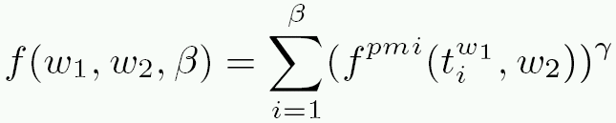
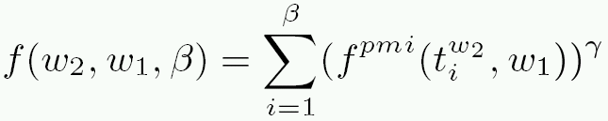


Semantic Similarity
PMI
f(w1, w2)
Problem: frequency is very low because prob. of two words in a sentence is small
Solution: SOC-PMI (Second Order PMI)
window
window
(Corpus)
“……………………………w1a,w1y,w1,w1c,w1h,………w1t,w1f,w1,w1g,w1n,……………………”
Remove the noisy value
Sorting PMI value
w2
w2
Notes:
用竖的list；
Appendix；
如何把所有的pmi合并；
说出key idea；
不需要解释具体的公式的意义；
综合考虑这三个，最后算出来总的结果。
取前面的n个值，不然就是你noisey，reasonable solution是把这些所有的值做一个平均。
取一个综合的线性的叠加。

Slide 49
Quick Search Similar Words (String-NLCS)
query: book pencil desk
book
pencil
desk
Threshold
Top-3
w8(0.95)
s1
, s9
w4(0.85)
s1, s9
w8(0.95)
s1, s18,s25
0.92
w8(0.90)
w6(0.85)
s1, s7, s2
w8(0.80)
s12, s1, s2
w6(0.85)
s6,
s1
,s12
0.83
w6(0.82)
0.75
w4(0.75)
w4(0.75)
s6, s1, s1
w6(0.75)
s1, s13
w3(0.75)
s36, s33, s11
0.68
s8, s2
s1
…
w3(0.70)
w3(0.65)
, s6
w2(0.70)
s18, s2
…
w7(0.65)
…
…
w4(0.65)
s1
Descending order of Similarity Value with query word
w1(0.55)
…
…
…
…
…
…
sentence1: #1(w6) #2(w8) #3(w2) #4(w9)
 | #1 | #2 | #3 | #4
book
pencil
desk
Compute the words by sentence;
Similar to NMLCS1,NMLCSn;
Depends on length of sentence.
w8
w6
w4
0.90+0.82+0.75=2.47

Slide 50
Effect on Dataset sizes
Query time
> Average query time by 10 queries
> Average query size = 3.52
Notes:
scale

Slide 51
 | Data Collection
 | 1k | 5k | 10k | 50k
Size
Avg. sentence length
Min sentence length
Max sentence length
Max word length

Slide 52








How to ordering
P: query sentence
Length = m
R: a sentence in data collection
Length = n
Ascending order: length of the sentence
w5(0.70)
w1(0.65)
…
…
…
…
s1
, s9
w8(0.95)
w2(0.85)
s5, s7, s2
?
w4(0.80)
s6, s3, s1
w3(0.75)
s8, s2
For word pair
w7(0.72)
s18, s3
s7, s32
s9, s5,s12
For example: m= 3

Slide 53
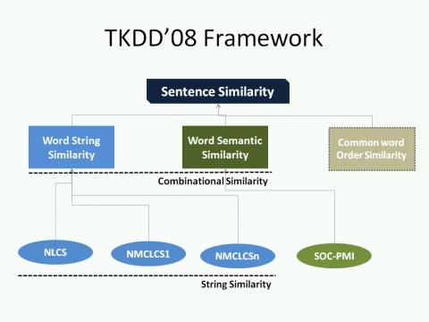





MCLCS1 = 4
String P
b | a | d | e | g
MCLCSn = 3
String R
n | b | a | d | f

